Slide 1

Convective-scale modelling: RMED and tropical process studies
Charmaine Franklin
Bureau of Meteorology

Slide 2
Regional Model Evaluation and Development
RMED is focussed on understanding and improving the convective-scale model
RA work is a shared activity of the UM consortium
RMED is about science collaboration
RA
Co-ordination
Verification
DA
Convection
Ensembles

Slide 3
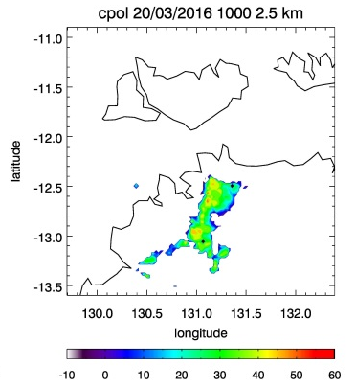
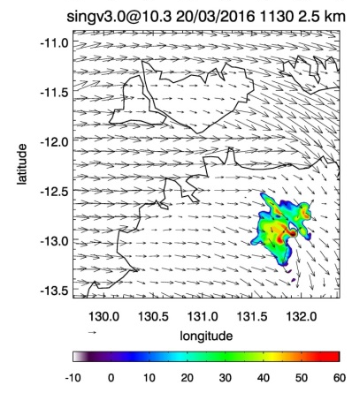
Organisation of convection
storm motion
Convective cells form on the leading edge of the observed squall
Convective cells form on the trailing edge of the simulated squall
Convective organisation affects duration, propagation & rainfall

Slide 4
Organisation of convection
storm motion
Convective cells form on the leading edge of the observed squall
Convective cells form on the trailing edge of the simulated squall
Convective organisation affects duration, propagation & rainfall

Slide 5
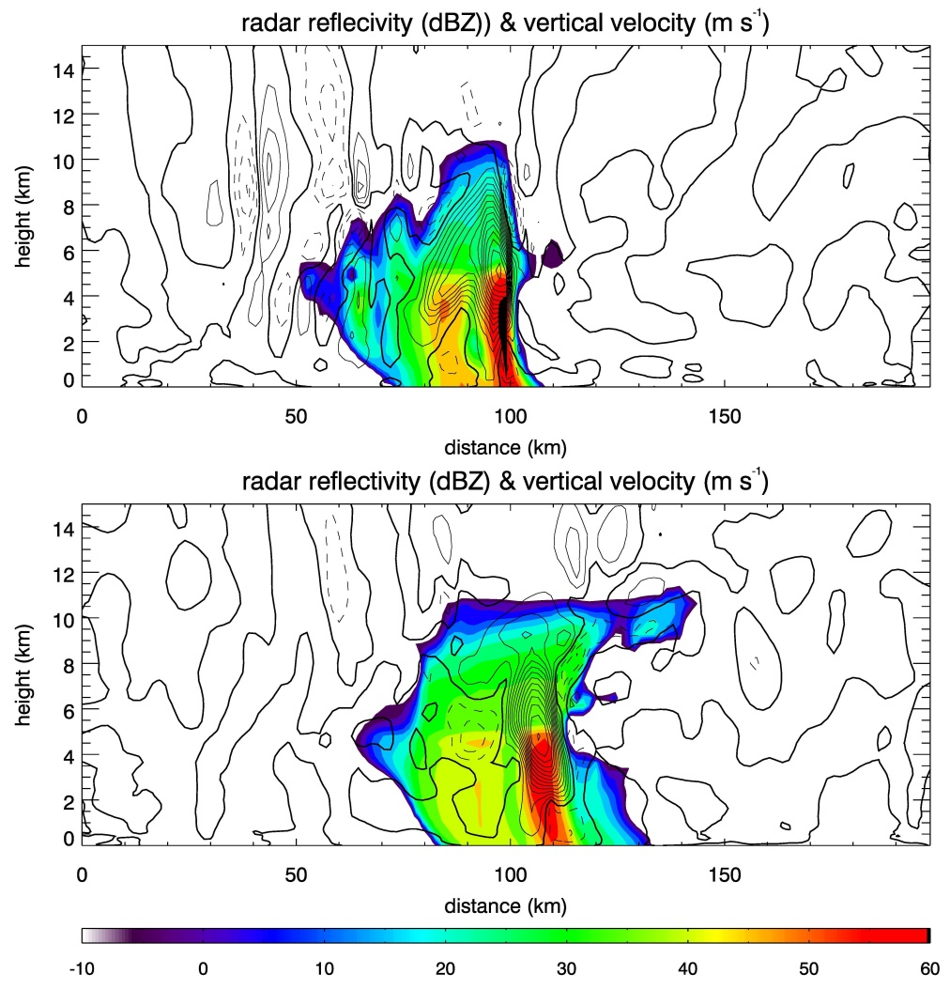
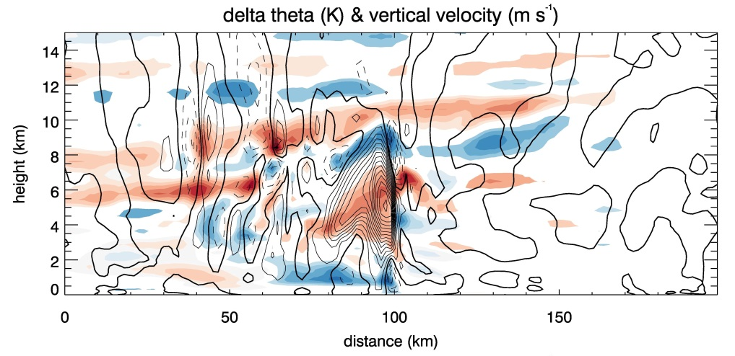
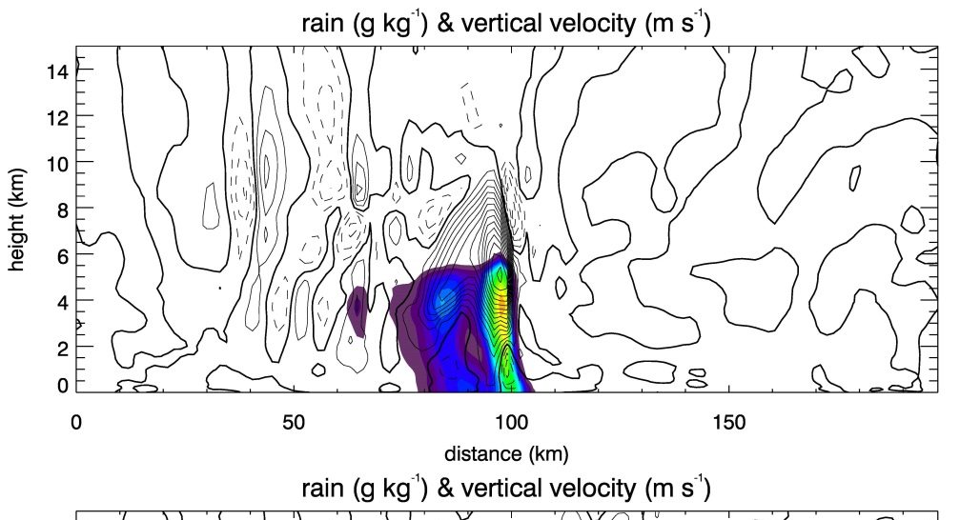


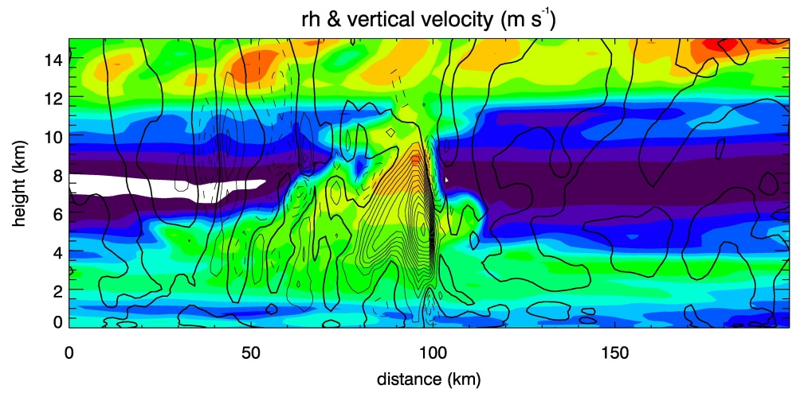

Squall line cross-section analysis
Gravity wave warms and dries upwind environment – prevents deep convection forming on leading edge
storm motion (upstream/leading edge – downstream/trailing edge)
Notes:
When we have heating in a stratified fluid the response is the generation of internal gravity waves.
Gravity wave triggered by convection is propagating upstream, and changing the environment that the storm is moving into.
Looking at the upstream environment, there is overall subsidence and warming away from the convection.
Inflow < 1km is high thetae but is capped by subsiding drier air that shifts the inflow from the lowest levels to higher up, which pushes drier air into the convection
- Convection still under-resolved so that leads to larger and stronger updrafts in models than in reality so we expect therefore that the gravity wave response in the model is stronger than in reality – incorrect convective organisation

Slide 6
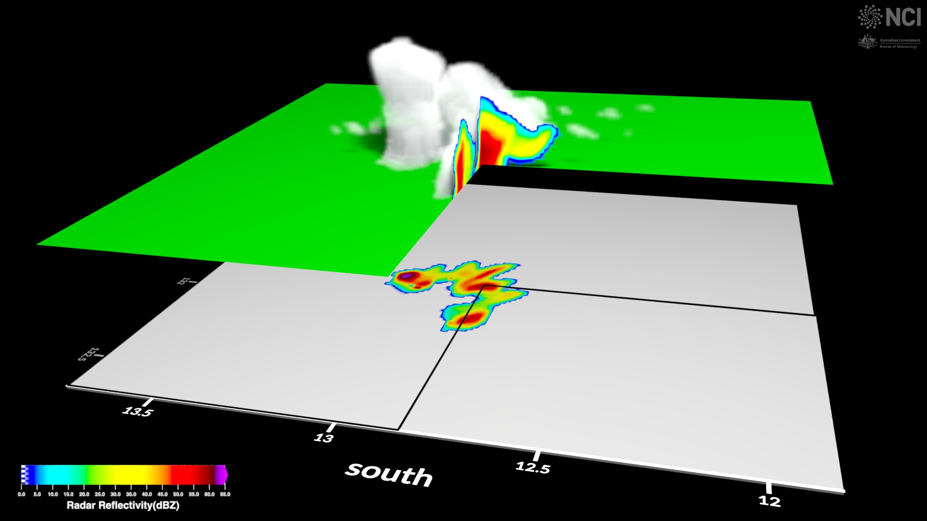
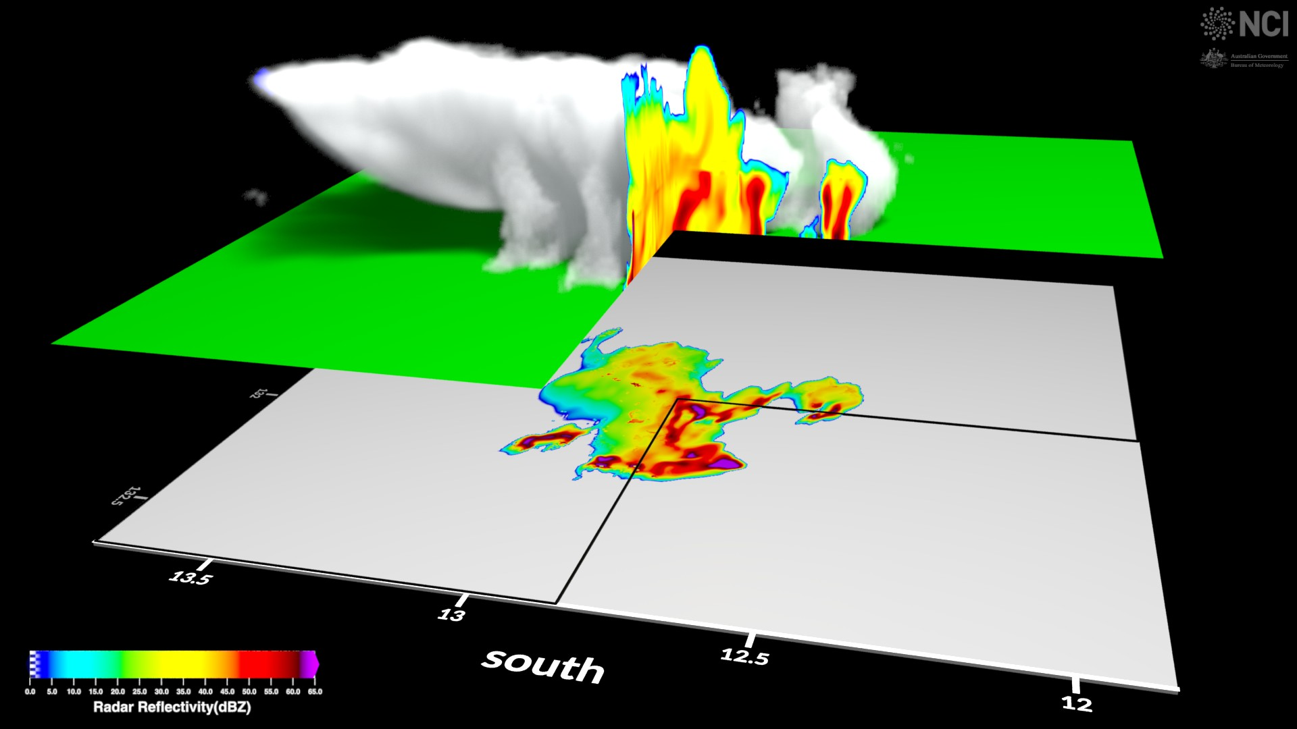
Sub-km scale simulations
1.5 km
400 m
storm motion
Convective cells too circular in 1.5km – under resolved
400m simulation produces a more realistic squall line in terms of convective organisation and convective-stratiform partitioning
Figures produced in collaboration with Drew Whitehouse NCI

Slide 7
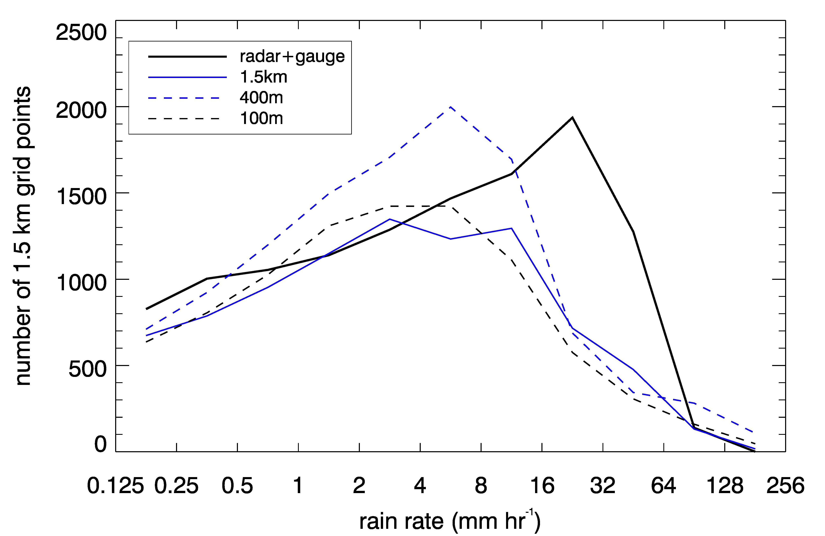
Rain rate distribution
100m simulation does not show an improvement
400m simulation produces closest agreement with observations
Focus is on developing scale-aware parameterisations

Slide 8
https://code.metoffice.gov.uk/trac/rmed/
Thank you…
charmaine.franklin@bom.gov.au

